Slide 1
Meeting 14
Monday 28/05/2018

Slide 2
Agenda
LES superposition
New results with updated TI
LES superposition with correction factor
Comparison: Park – LES
How to quantify the wake differences?

Slide 3
LES superposition
First calculating rotor averaged wind speed, then performing superposition → same result as first superposition and then calculation of rotor averaged wind speed
Single wakes
 | U0 | TI | CT
Wake 1 | 14 m/s | 3,6% | 0,46
Wake 2a | 11,2 m/s | 3,6% | 0,65
Wake 2b | 11,2 m/s | 8,6% | 0,65
Wake 3 | 8,55 m/s | 3,6% | 0,79

Slide 4
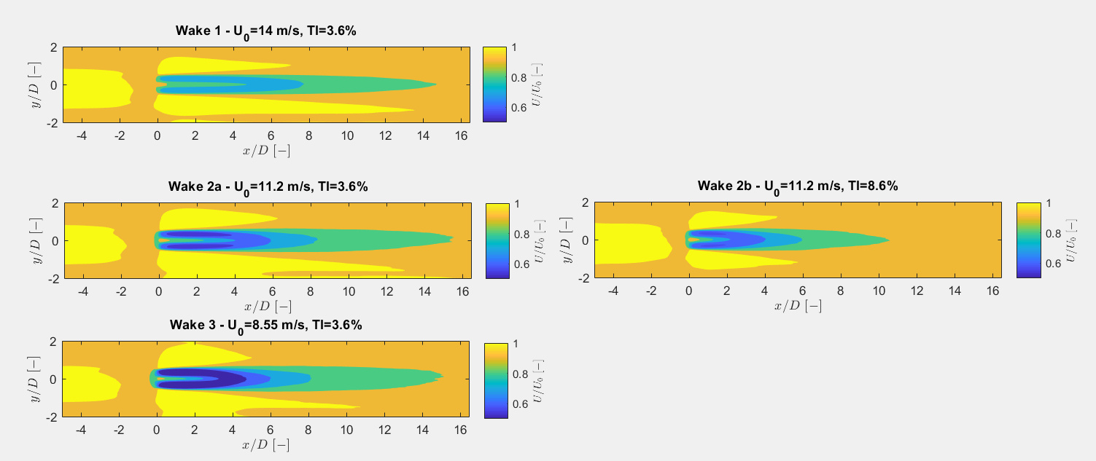
LES superposition – single wakes

Slide 5
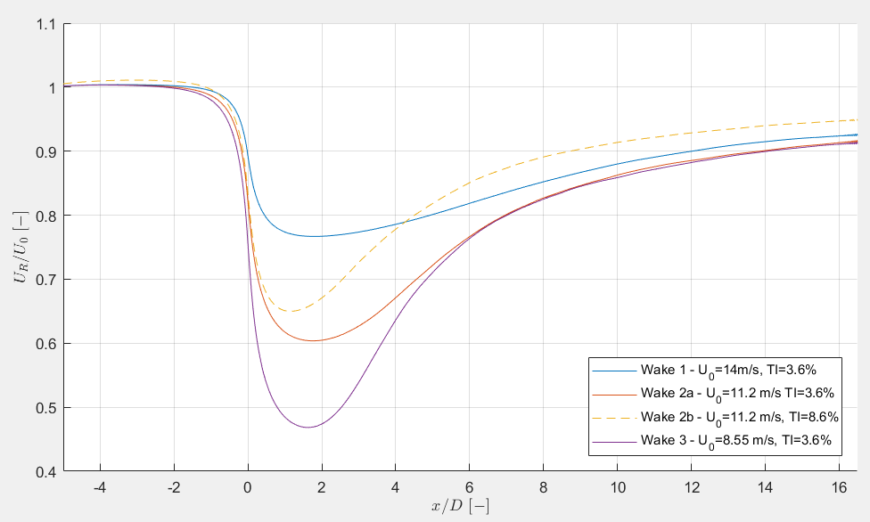
LES superposition – single wakes

Slide 6
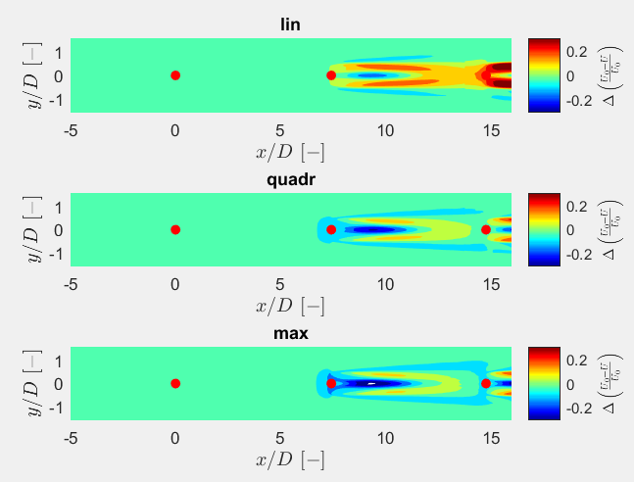
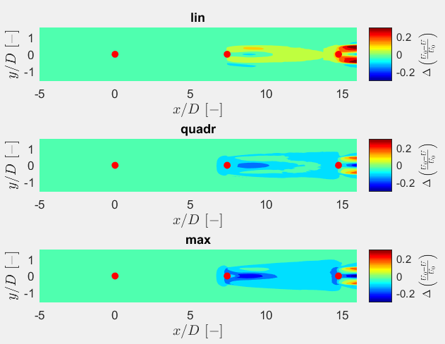
LES superposition
Wake 1 + wake 2a + wake 3
Wake 1 + wake 2b + wake 3

Slide 7
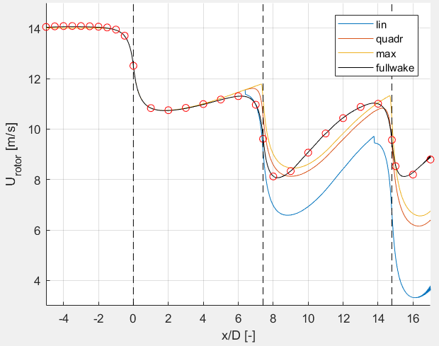
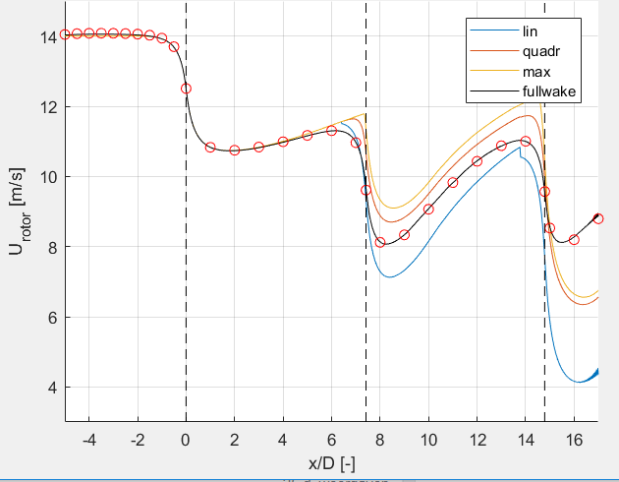
LES superposition
Wake 1 + wake 2a + wake 3
Wake 1 + wake 2b + wake 3

Slide 8
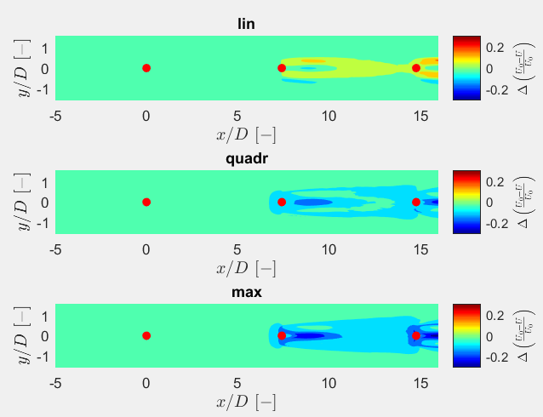
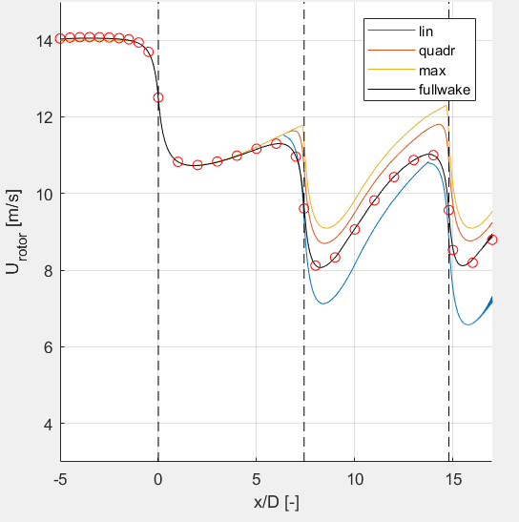
LES superposition
Wake 1 + wake 2b + wake 2b

Slide 9
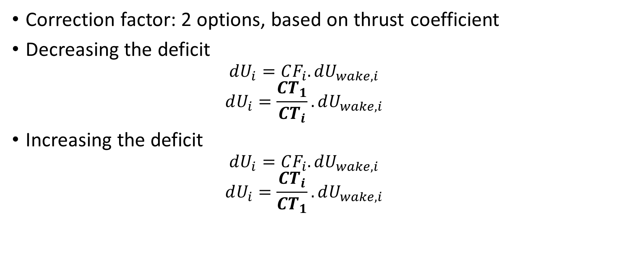
LES superposition – with correction factor
Correction factor: 2 options, based on thrust coefficient
Decreasing the deficit
$$dU_{i}=CF_{i}.dU_{wake,i}$$
$$dU_{i}=\frac{CT_{1}}{CT_{i}}. dU_{wake,i}$$
Increasing the deficit
$$dU_{i}=CF_{i}.dU_{wake,i}$$
$$dU_{i}=\frac{CT_{i}}{CT_{1}}. dU_{wake,i}$$

Slide 10
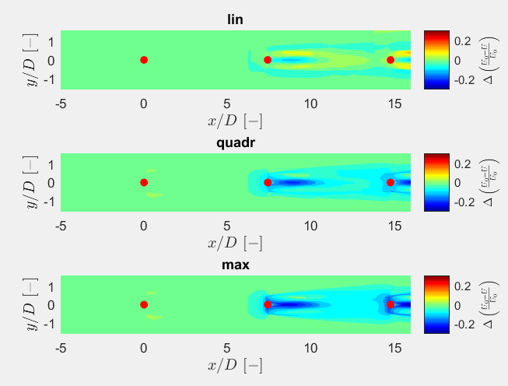
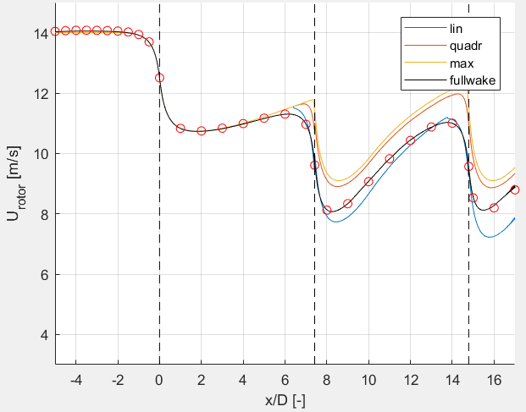
LES superposition – decreasing CF
Wake 1 + wake 2b + wake 2b (with decreasing CF)

Slide 11
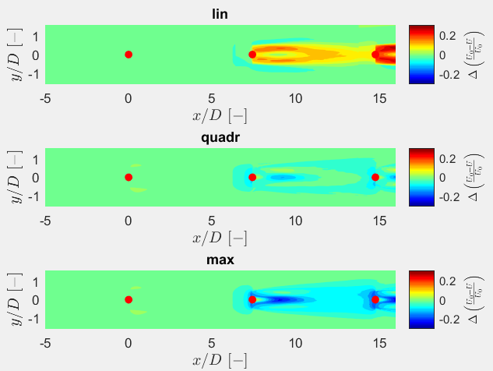
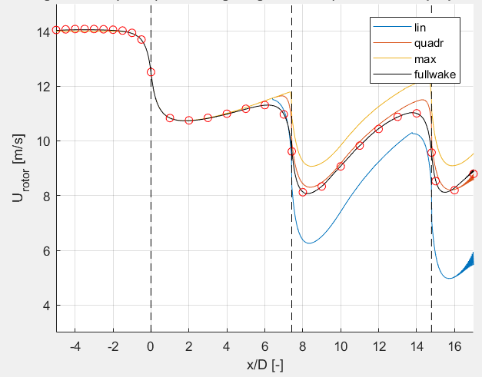
LES superposition – increasing CF
Wake 1 + wake 2b + wake 2b (with increasing CF)

Slide 12
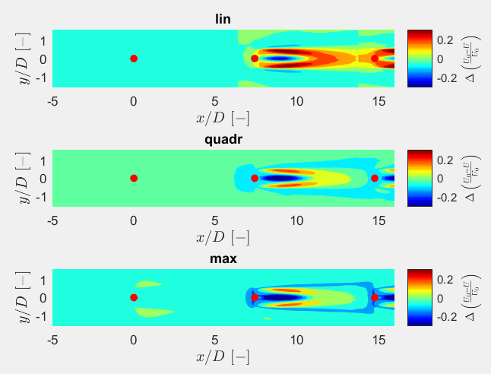
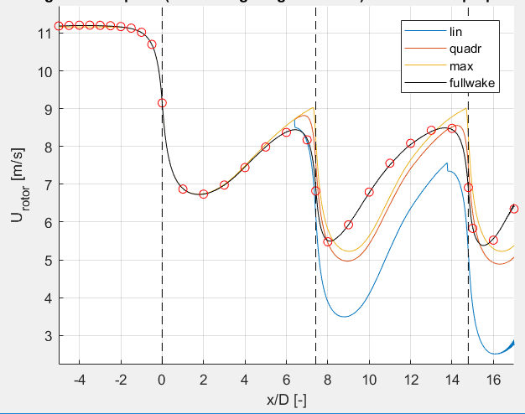
LES superposition – U0=11,2
TI should be higher
Deficit will be lower
Max deficit will occur at smaller x/D
Wake 2 + wake 3 + wake 3

Slide 13
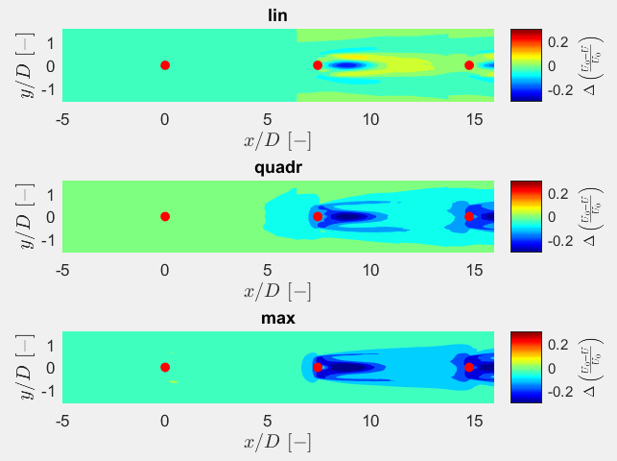
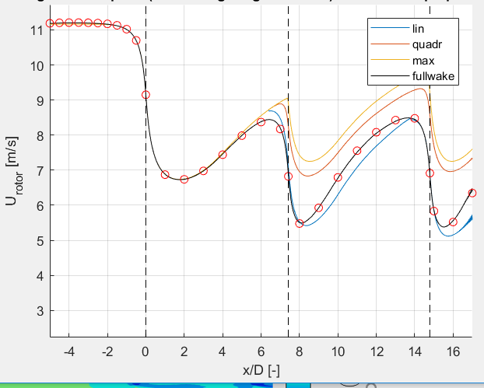
LES superposition – U0=11,2
CT should be higher
Higher deficit
TI is correct
→ Good trend
Wake 2 + wake 2b + wake 2b

Slide 14
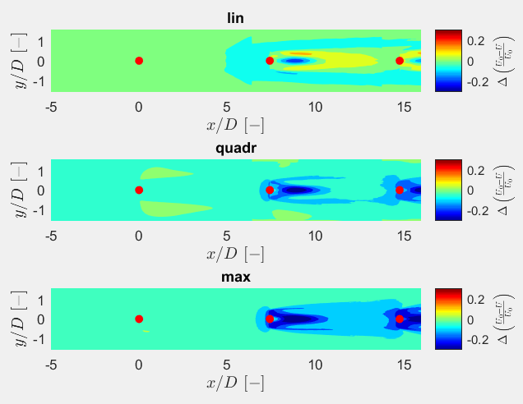
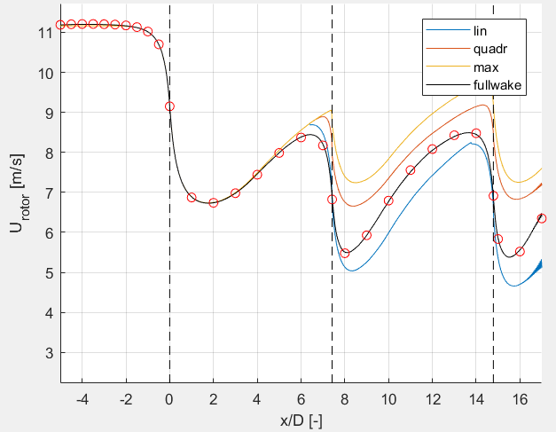
LES superposition – U0=11,2
Trend good because of TI
Wake 2 + wake 2b + wake 2b (with increasing CF)

Slide 15
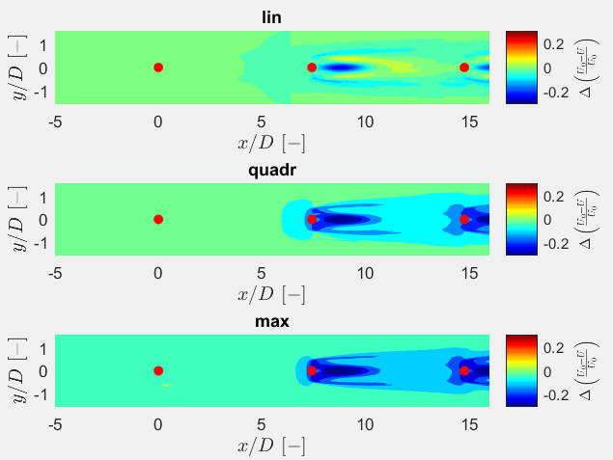
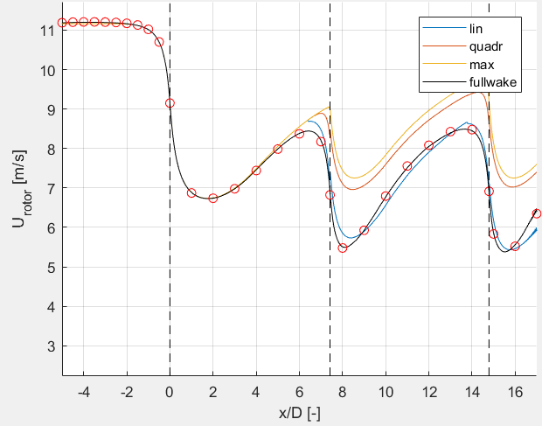
LES superposition – U0=11,2
Trend good because of TI
Gives good results for linear superposition
Wake 2 + wake 2b + wake 2b (with decreasing CF)

Slide 16
Comparison: Park - LES
U0=14 m/s
k=0,03
Wake reflection: not included as no hub height (difference small for quadratic and max deficit superposition)
6 cases:
3 superposition methods: linear, quadratic, maximum deficit
Correction method: true or false

Slide 17
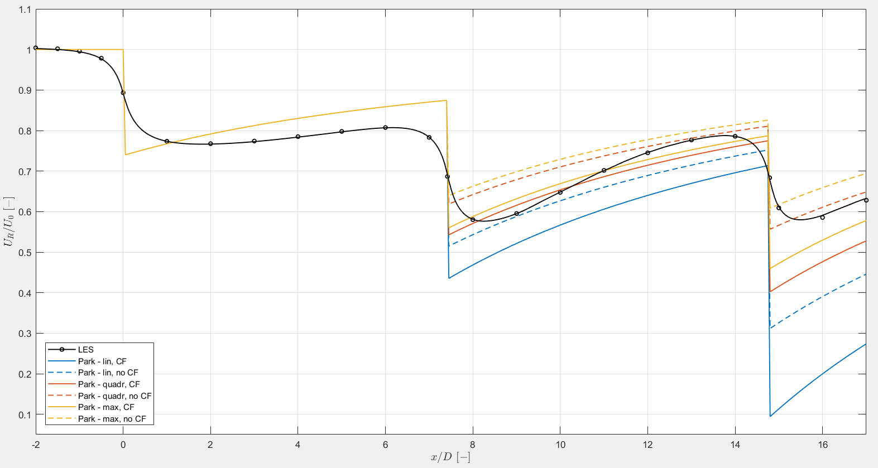
Comparison: Park - LES

Slide 18
How to quantify the wake differences?
7 ratings based on the relative difference between LES and Park model
Minimum rotor averaged wind speed
Wake 2
Wake 3
Mean wind speed field of a wake
Wake 2
Wake 3
Rotor averaged wind speed at far wake
Wake 2
Whole mean wind speed field
Mean of slope of rotor averaged wind speed: dU/dx (wake recovery)
Wake 2

Slide 19
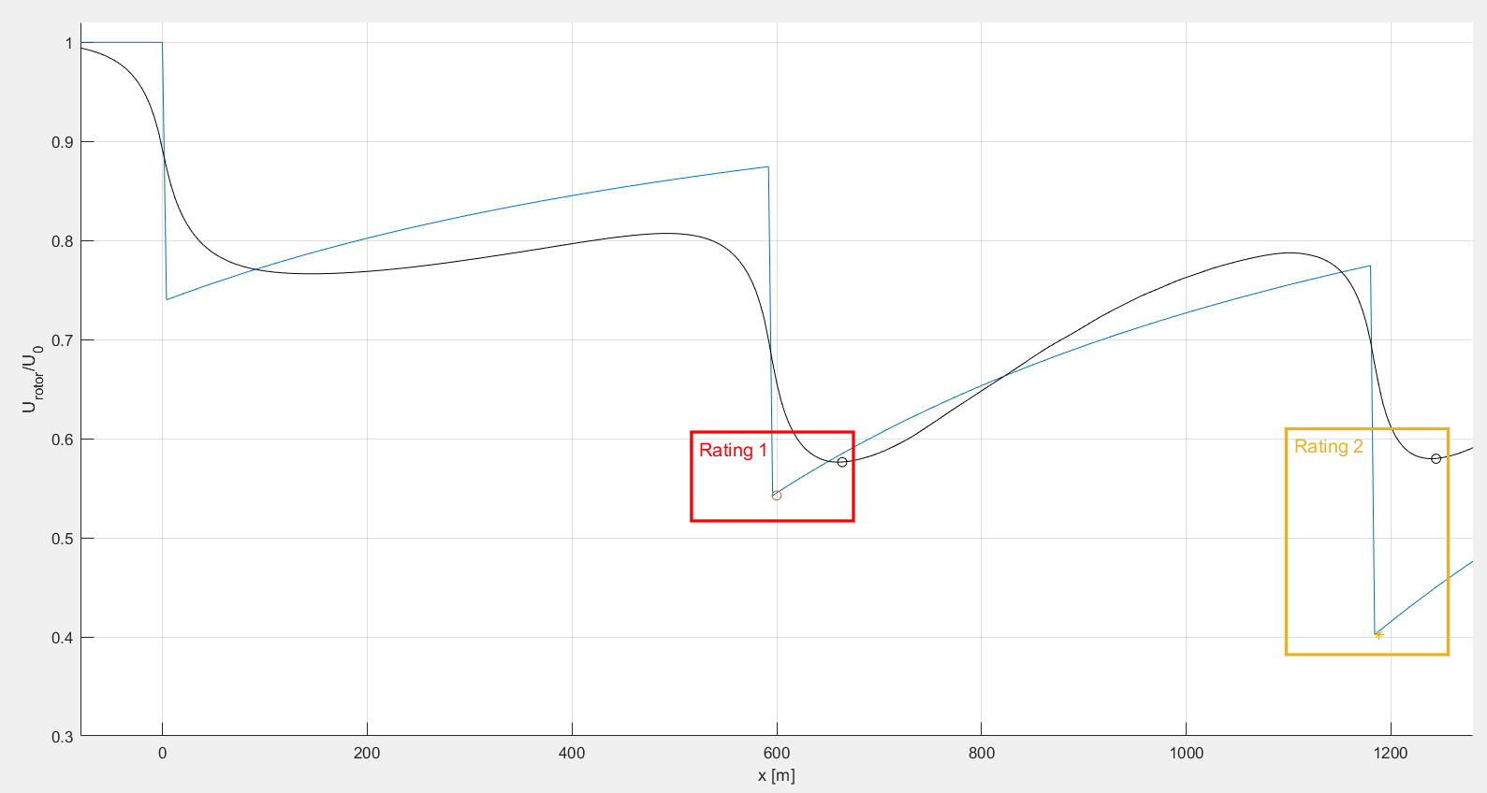
How to quantify the wake differences?
7 ratings based on the relative difference between LES and Park model
Minimum rotor averaged wind speed
1) Wake 2
2) Wake 3
Mean wind speed field of a wake
3) Wake 2
4) Wake 3
Rotor averaged wind speed at far wake
5) Wake 2
6) Whole mean wind speed field
Mean of slope of rotor averaged wind speed: dU/dx
7) Wake 2

Slide 20
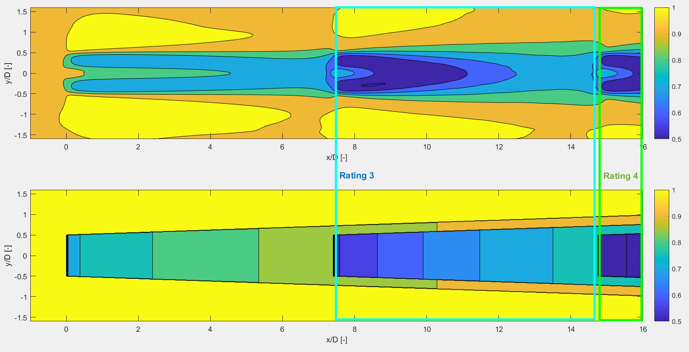
How to quantify the wake differences?
7 ratings based on the relative difference between LES and Park model
Minimum rotor averaged wind speed
1) Wake 2
2) Wake 3
Mean wind speed field of a wake
3) Wake 2
4) Wake 3
Rotor averaged wind speed at far wake
5) Wake 2
6) Whole mean wind speed field
Mean of slope of rotor averaged wind speed: dU/dx
7) Wake 2

Slide 21
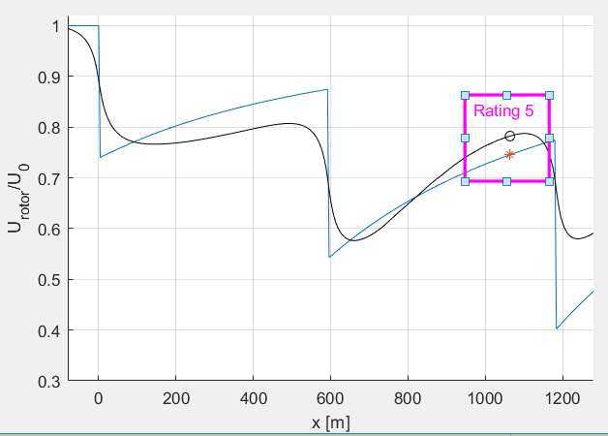
How to quantify the wake differences?
7 ratings based on the relative difference between LES and Park model
Minimum rotor averaged wind speed
1) Wake 2
2) Wake 3
Mean wind speed field of a wake
3) Wake 2
4) Wake 3
Rotor averaged wind speed at far wake
5) Wake 2
6) Whole mean wind speed field
Mean of slope of rotor averaged wind speed: dU/dx
7) Wake 2

Slide 22
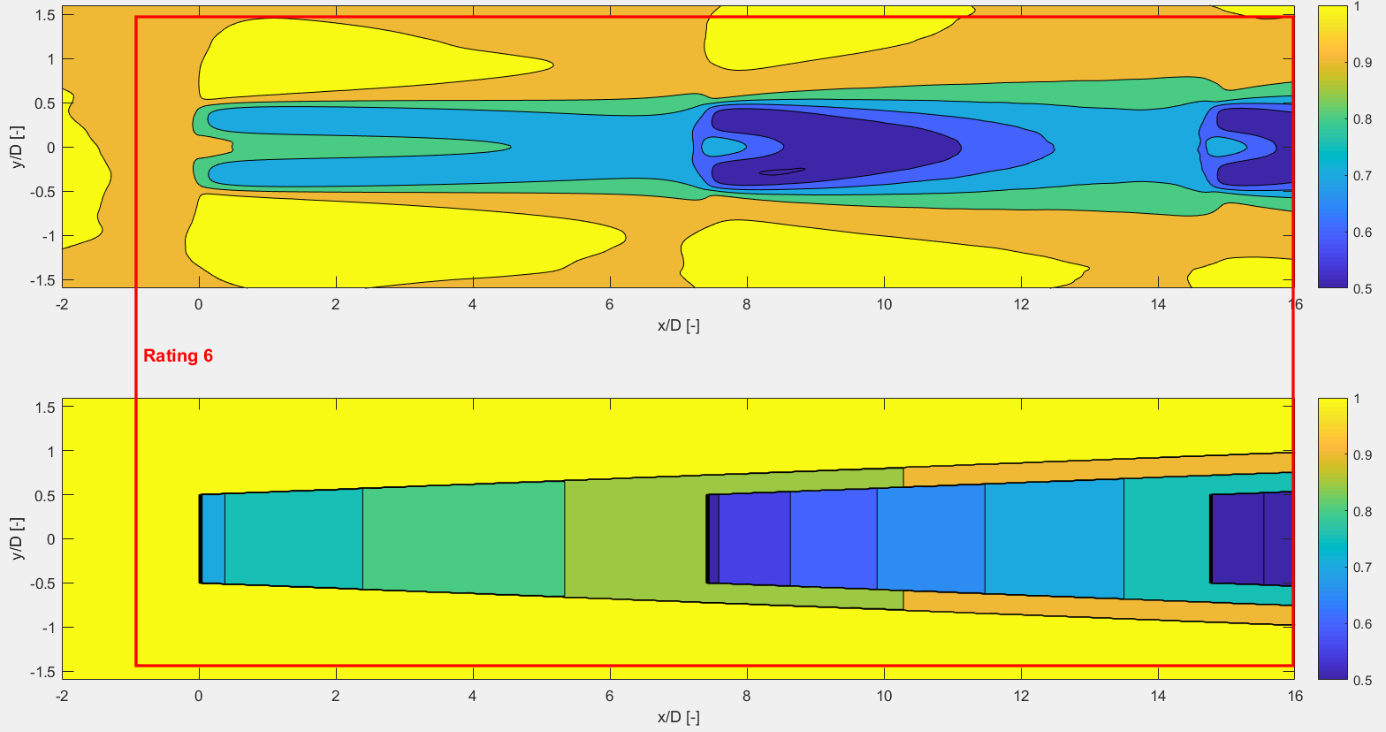
How to quantify the wake differences?
7 ratings based on the relative difference between LES and Park model
Minimum rotor averaged wind speed
1) Wake 2
2) Wake 3
Mean wind speed field of a wake
3) Wake 2
4) Wake 3
Rotor averaged wind speed at far wake
5) Wake 2
6) Whole mean wind speed field
Mean of slope of rotor averaged wind speed: dU/dx
7) Wake 2

Slide 23
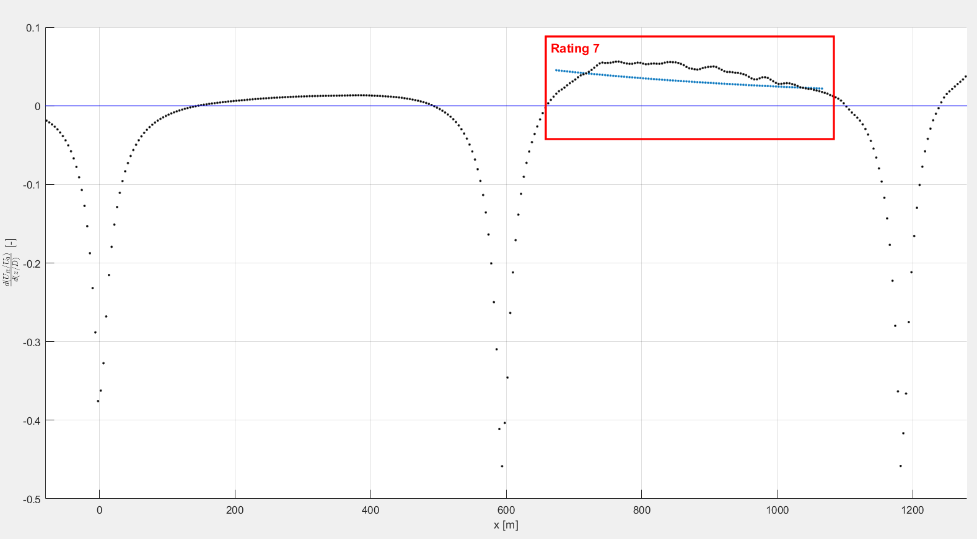
How to quantify the wake differences?
7 ratings based on the relative difference between LES and Park model
Minimum rotor averaged wind speed
1) Wake 2
2) Wake 3
Mean wind speed field of a wake
3) Wake 2
4) Wake 3
Rotor averaged wind speed at far wake
5) Wake 2
6) Whole mean wind speed field
Mean of slope of rotor averaged wind speed: dU/dx
7) Wake 2

Slide 24
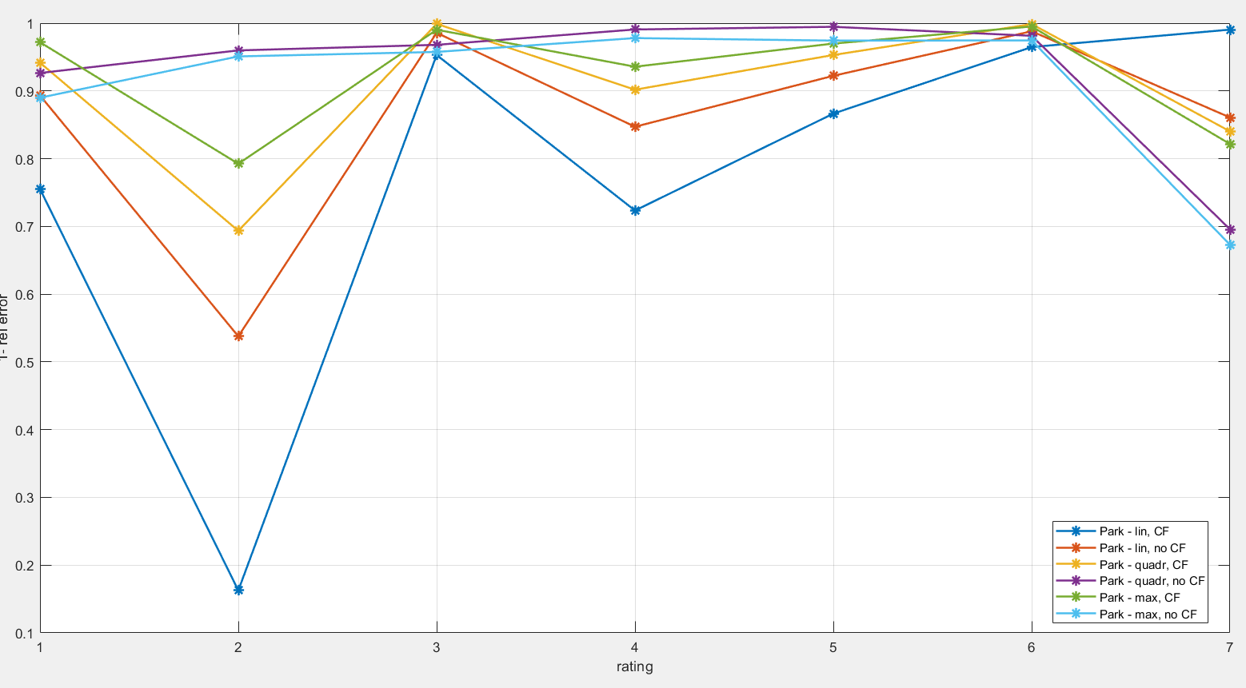
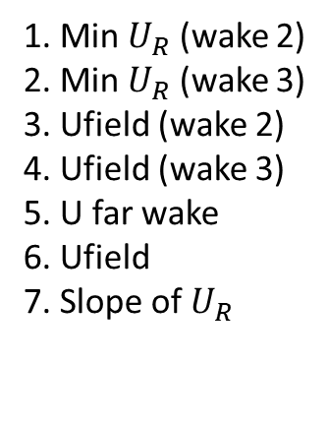
How to quantify the wake differences?
What is the total rate?
Give them all the ratings the same weights?
1. Min $U_{R}$ (wake 2)
2. Min $U_{R}$ (wake 3)
3. Ufield (wake 2)
4. Ufield (wake 3)
5. U far wake
6. Ufield
7. Slope of $U_{R}$

Slide 25
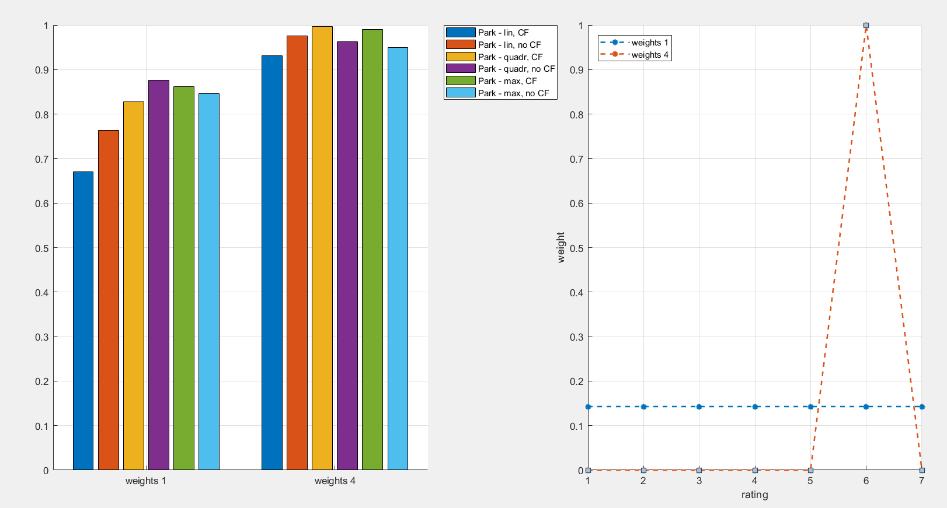
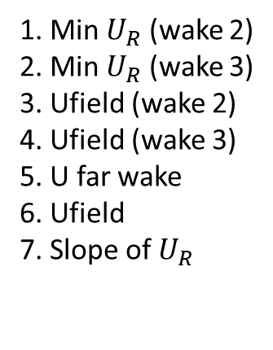
How to quantify the wake differences?
1. Min $U_{R}$ (wake 2)
2. Min $U_{R}$ (wake 3)
3. Ufield (wake 2)
4. Ufield (wake 3)
5. U far wake
6. Ufield
7. Slope of $U_{R}$

Slide 26
Next steps
Comparison with BEACon
More than 2,5 wakes?
Fuga
Very high hub height not possible to compare with uniform inflow
Other options?
Next meeting? 5/06/2018 at 14:00 12/06/2018 at 14:00

